Slide 1
Polynote vs. Jupyter
Prepared by :
Amit Samra
Preeti Sehgal
James Thompson

Slide 2
Origin
Computational Notebooks are virtual environments used for coding. Collection of ordered cells.
1988 Wolfram Mathematica on Mac
Now MATLAB, Python, Julia, Scala, SQL and more.
Open-source notebook for data science / machine learning.
Created by Netflix to overcome shortcomings of existing notebook tools for Scala.

Slide 3
Special Features
Reproducibility – cells position is taken into account when executing (no hidden cells). Keeping track of variables defined in each cell > principle of least surprise.
Visibility – expanded view of kernel by highlighting currently-running cell code without going into logs.
For Polyglots but emphasis on Scala.
Editing Improvements: IDE-like features such as autocomplete, parameter hints and error highlighting.
Native data exploration and visualization.
Dependency and configuration management – setup saved within notebook itself rather than external files.

Slide 4
Comparison to Jupyter
Open source.
Data Science / Machine Learning.
Polyglot.
Jupyter: Python, Ruby, R
Polynote: Python, Scala, SQL
Visualization via matplotlib.

Slide 5
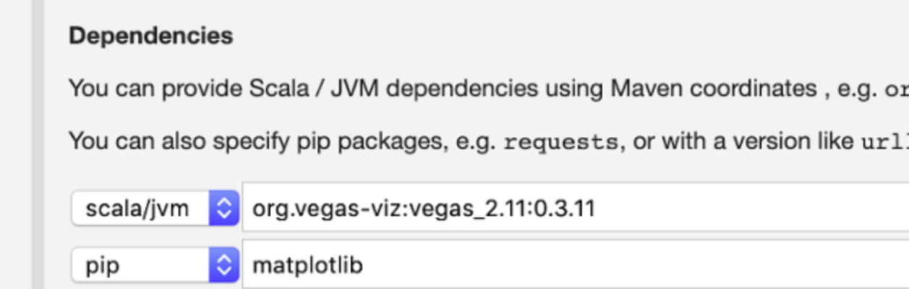
Contrast to Jupyter
In-Notebook Multiple Language Support*
Polynote can support Python, Scala, and SQL languages at the same time in one notebook.
It does this by sharing the different language cells variables between cells in the notebook, enabling different languages to work seamlessly together
Reproducibility of Code
A big difference is that Juypter uses REPL where Polynote is more like writing a script
Results in consistent code, better shareability, but less flexibility
Built in Visualization and Data Awareness
No need to pip Install
GUI to viewdata and value of variables
Progress window

Slide 6
Use cases best suited for Polynote
( where you might use this instead of Jupyter )
Heavy requirements for data visualization.
Polynote is best suited if the requirements are heavy on data visualization.
It has a Built-in data visualization GUI which means less code to write and faster turnarounds
Requirement for multiple languages in a single notebook
Polynote allows multiple languages in one notebook
Easier to collaborate with resources using different languages for the same deliverable
The sequence of cell execution is critical
Polynote is rigid on the sequence of cell execution
Reduces possible errors due to out of sequence execution of cells
Heavy requirement for text outputs
Polynote has WYSIWIG (What You See Is What You Get) editor
Reduces time for testing text outputs

Slide 7
Recommendation
It’s a relatively new tool and what makes or breaks a product is the network effect. It may not be worthwhile investing in a new technology that has yet to be proven outside Netflix.

Slide 8
Sources
https://en.wikipedia.org/wiki/Notebook_interface
https://polynote.org/
https://github.com/polynote/polynote
https://netflixtechblog.com/open-sourcing-polynote-an-ide-inspired-polyglot-notebook-7f929d3f447
https://medium.com/@brianray_7981/did-netflix-just-kill-databricks-with-releasing-polynote-for-free-c2d1f6dc0da3
https://hackernoon.com/what-you-need-to-know-about-netflixs-jupyter-killer-polynote-gb2a27yd
https://stackoverflow.com/questions/39008069/r-and-python-in-one-jupyter-notebook
https://towardsdatascience.com/what-you-need-to-know-about-netflixs-jupyter-killer-polynote-dbe7106145f5

